Slide 1


Reduced-Dimensional Neural Network Surrogate Construction and Calibration of the E3SM Land Model
Khachik Sargsyan (SNL), Daniel Ricciuto (ORNL)
CLM/PPE Webinar
Feb 15, 2024

Slide 2
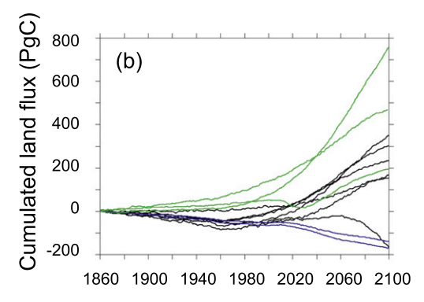

Motivation and Overview
Land-surface model parametric uncertainty remains large
High model expense → Need for model surrogates for sample-intensive studies,
such as …
Global sensitivity analysis (forward UQ)
Model calibration (inverse UQ)
Major challenges
Expensive model evaluation, small ensembles
High dimensional (spatio-temporal) outputs
Friedlingstein, 2014
Reduced-dimensional, inexpensive surrogate construction via
Karhunen-Loève expansions and Neural Networks (KLNN)
Surrogate enables global sensitivity analysis and Bayesian model calibration

Slide 3

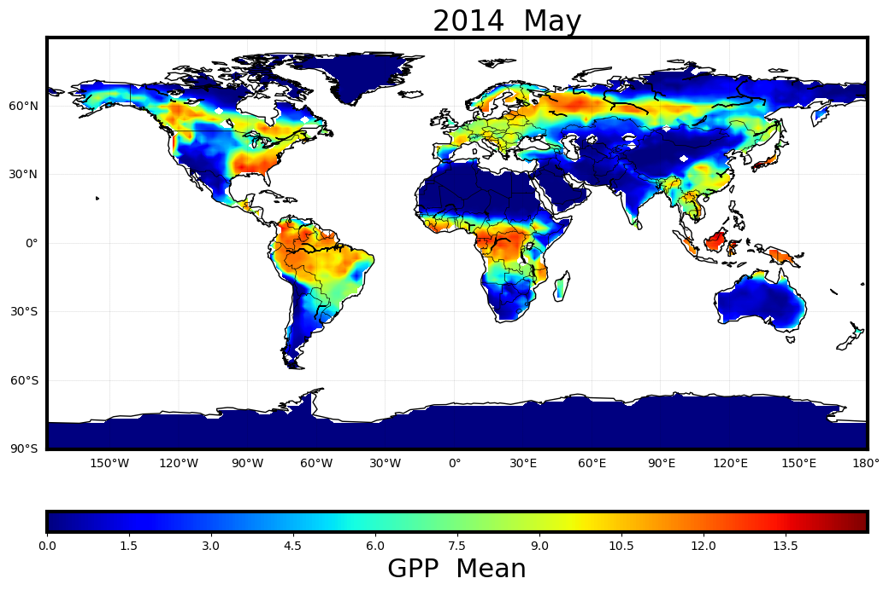
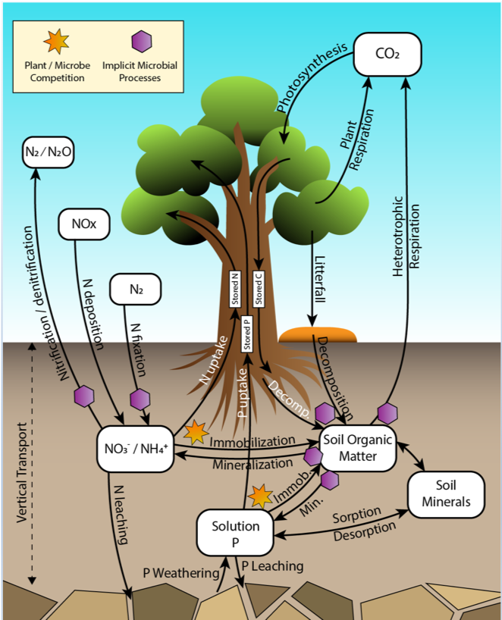
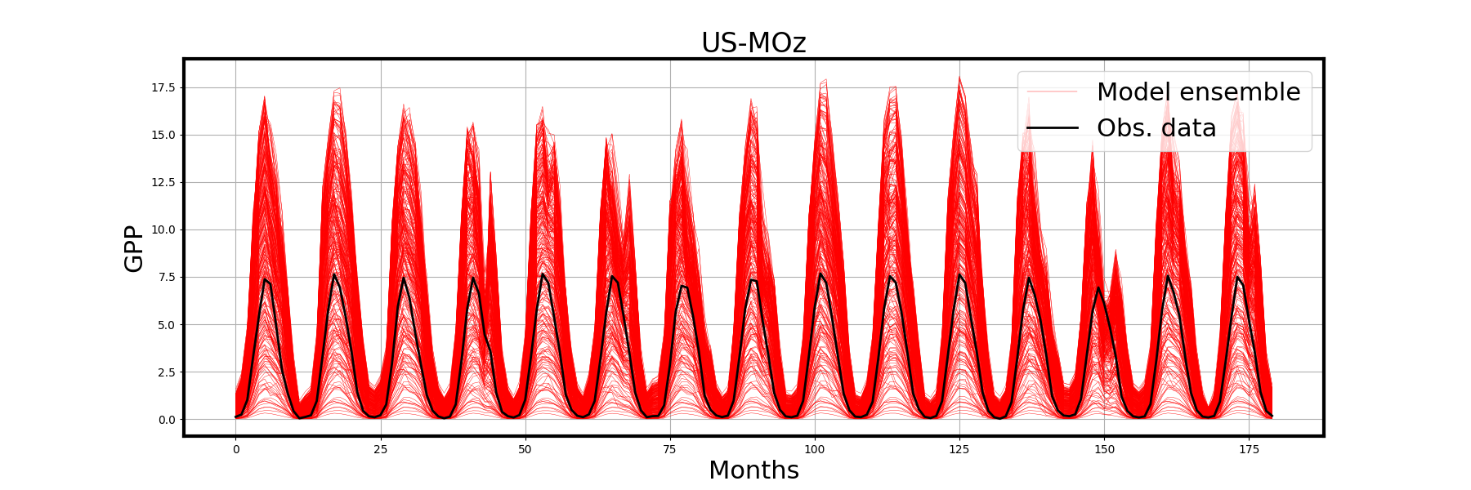
E3SM Land Model (ELM): focus on carbon and energy cycle
Satellite Phenology version used for this study (close to CLM4.5)
Quantity of Interest:
Gross primary productivity (GPP)…
… resolved in space, …
… and in time.
Notes:
This work focuses on the satellite phenology version of ELM, which does not track carbon and nutrients. If anyone asks, we are working to extend this ensemble to the BGC-enabled version.

Slide 4
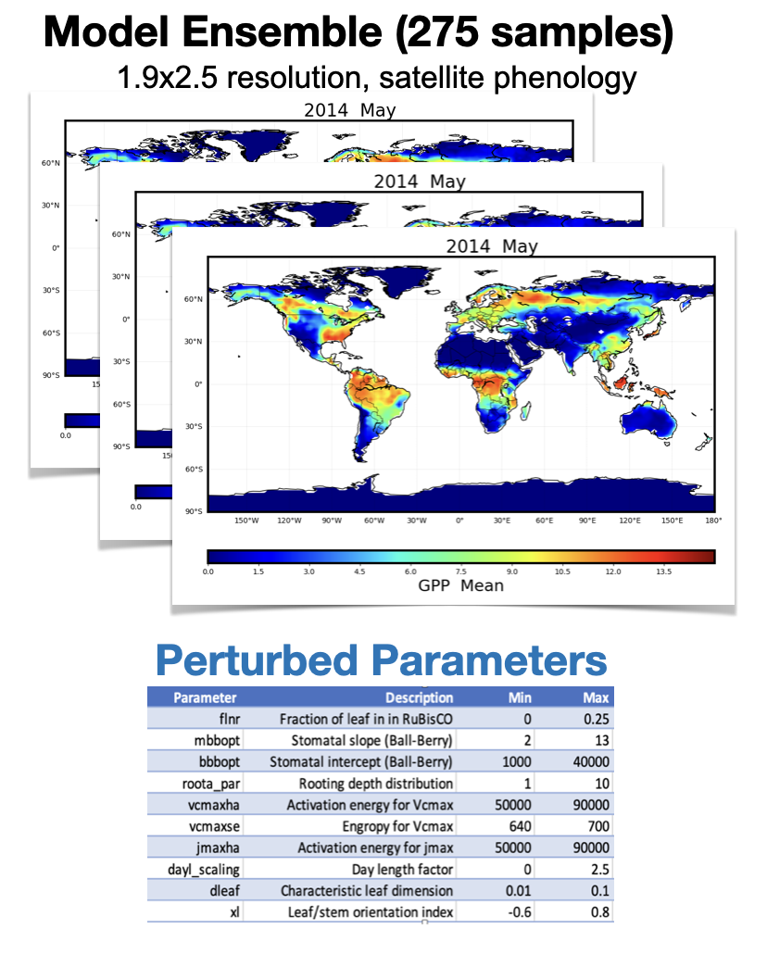
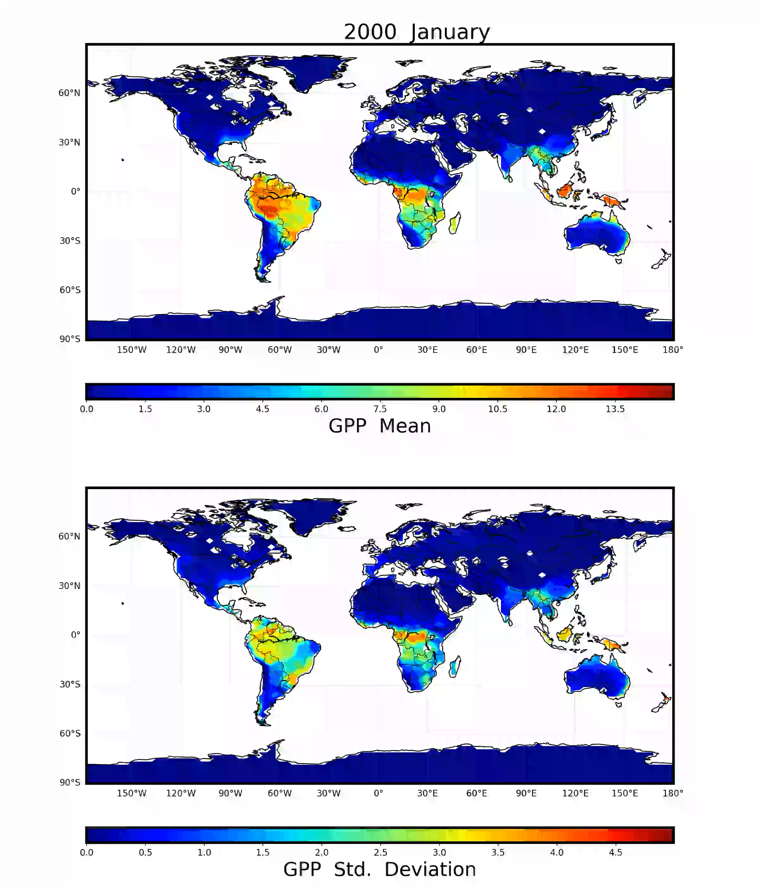

Slide 5
Forward UQ a.k.a. surrogate construction, global sensitivity analysis, uncertainty propagation

Slide 6
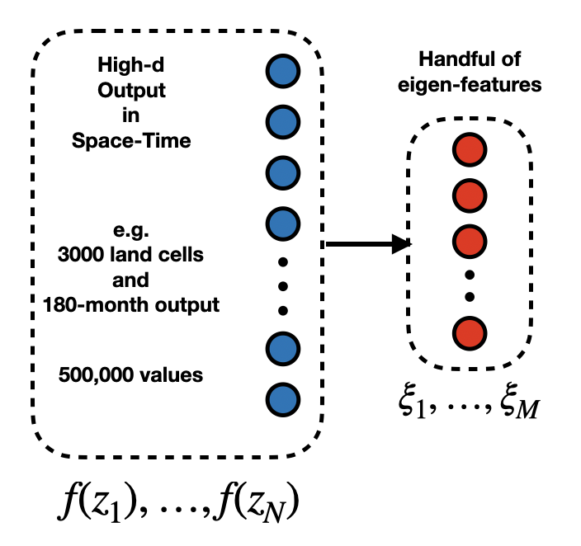

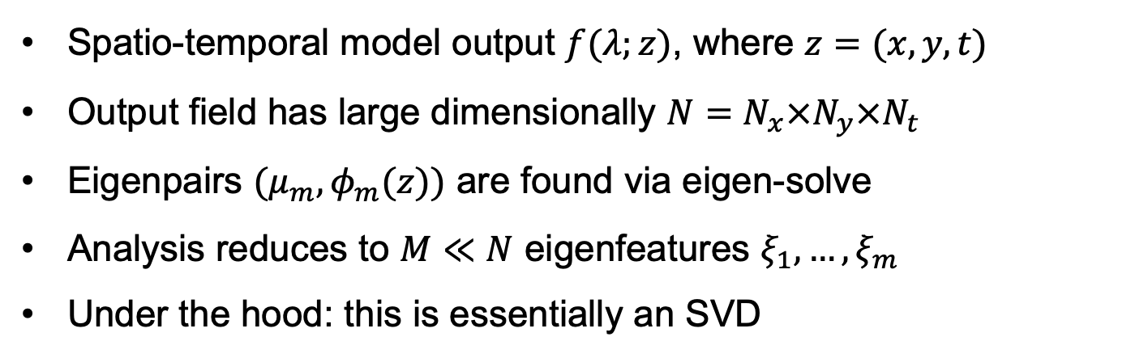
Dimensionality Reduction via Karhunen-Loève Expansion
$$f(λ;z)≈\overline{f}(z)+\overset{M}{\underset{m=1}{∑}}ξ_{m}(λ)\sqrt{μ_{m}}φ_{m}(z)$$
Uncertain parameters
“Certain” conditions
Spatio-temporal model output $f(λ;z)$, where $z=(x,y,t)$
Output field has large dimensionally $N=N_{x}×N_{y}×N_{t}$
Eigenpairs $(μ_{m},φ_{m}(z))$ are found via eigen-solve
Analysis reduces to $M≪N$ eigenfeatures $ξ_{1},…,ξ_{m}$
Under the hood: this is essentially an SVD

Slide 7
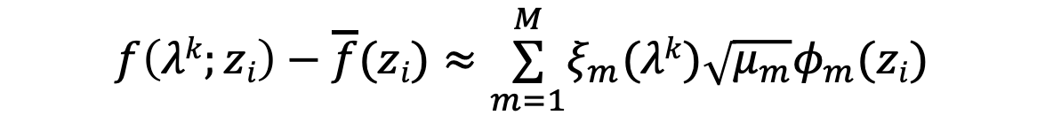
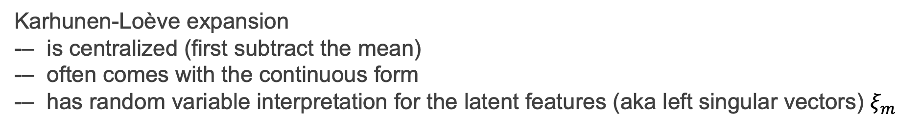

KL is essentially a Singular Value Decomposition
$$f\left(λk;zi\right)−\overline{f}(zi)≈\overset{M}{\underset{m=1}{∑}}ξ_{m}(λk)\sqrt{μ_{m}}φ_{m}(zi)$$
KL
$$Fki\overset{ M}{=\underset{m=1}{∑}}UkmΣmmVim$$
$$F\overset{ }{=}U Σ VT$$
SVD
Karhunen-Loève expansion
-– is centralized (first subtract the mean)
-– often comes with the continuous form
-– has random variable interpretation for the latent features (aka left singular vectors) $ξ_{m}$

Slide 8
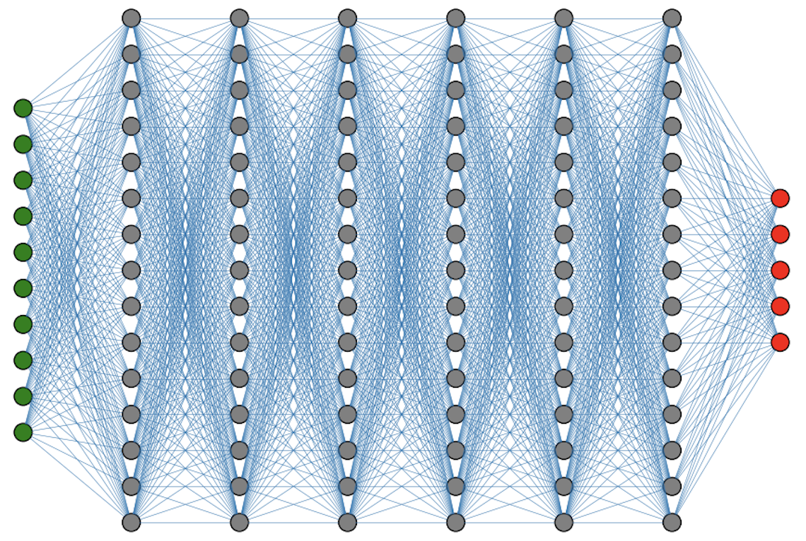
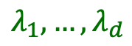
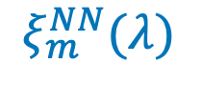
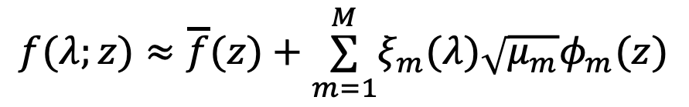
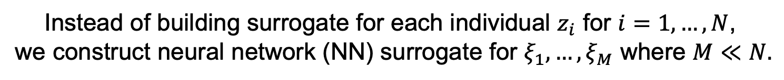
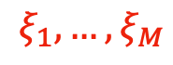
KL+NN = reduced dimensional spatio-temporal surrogate
The goal is to construct a surrogate with respect to uncertain parameters $λ$, such that $f(λ;z_{i})≈f_{s}(λ;z_{i})$ for all conditions $z_{i}$.
Instead of building surrogate for each individual $z_{i}$ for $i=1,…,N$,
we construct neural network (NN) surrogate for $ξ_{1},…,ξ_{M}$ where $M≪N.$
$$f(λ;z)≈\overline{f}(z)+\overset{M}{\underset{m=1}{∑}}ξ_{m}(λ)\sqrt{μ_{m}}φ_{m}(z)$$
Eigen-
features
Input Parameters
$$λ_{1},…,λ_{d}$$
$$ξ_{1},…,ξ_{M}$$
$$ξ_{m}^{NN}(λ)$$

Slide 9
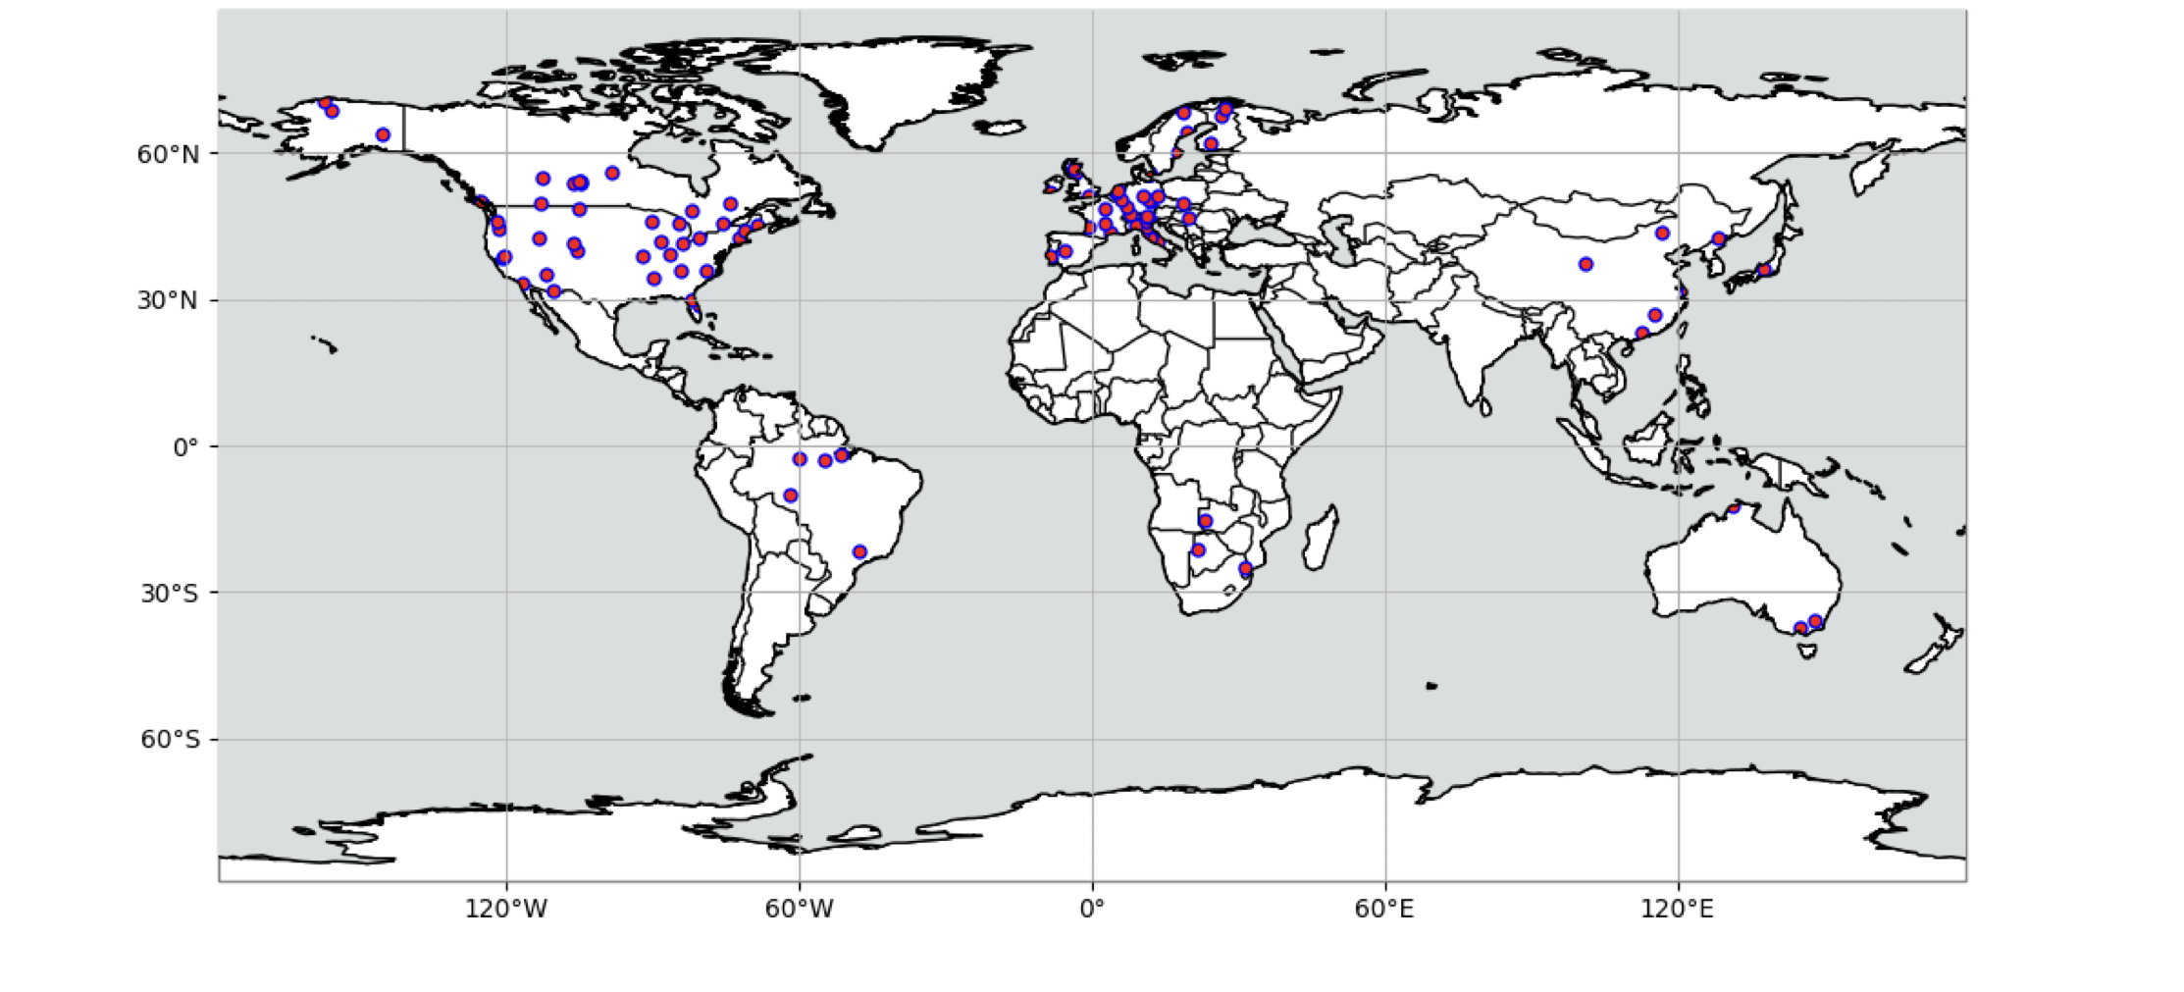
Methodological evaluation at 96 FLUXNET sites
Notes:
A selection of FLUXNET with long data records, covering diverse geographic areas and PFTs.

Slide 10
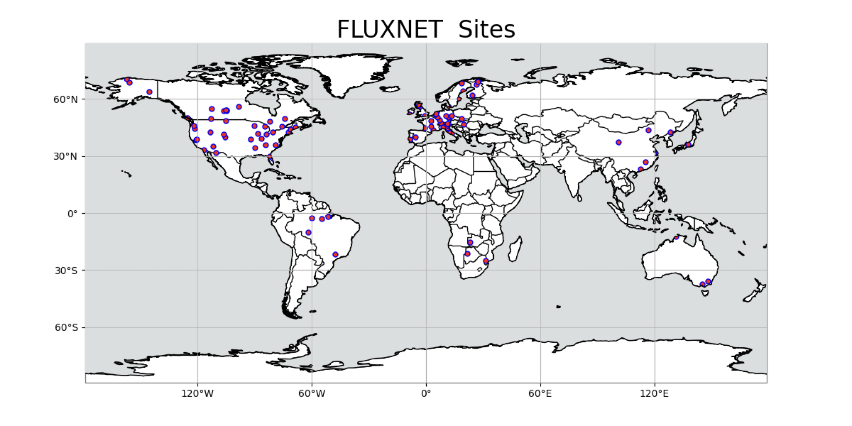
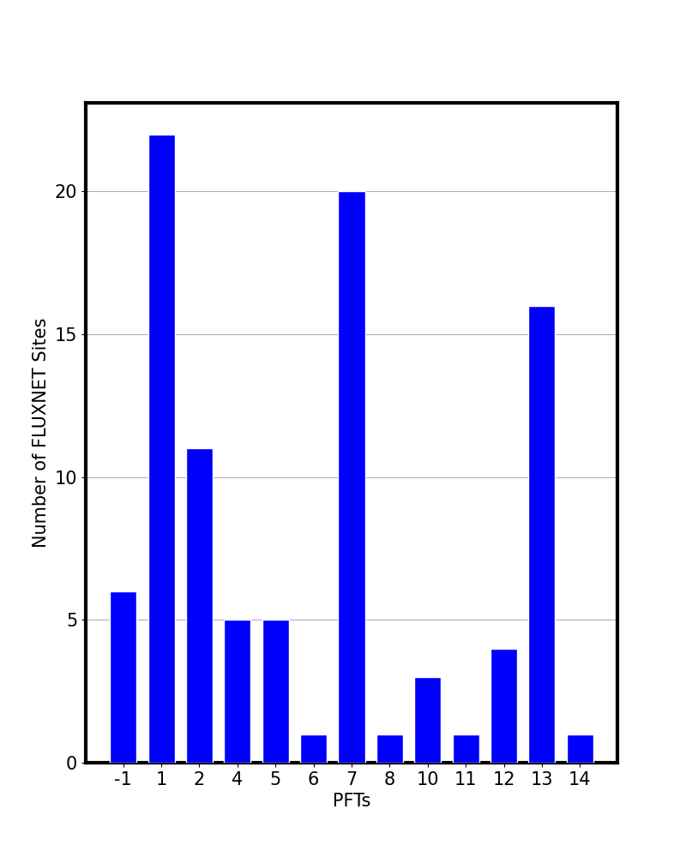
ID | PFT Name | Count
1 | Boreal evergreen needleleaf tree | 22
2 | Temperate evergreen needleleaf tree | 11
3 | Boreal deciduous needleleaf tree | 0
4 | Tropical evergreen broadleaf tree | 5
5 | Temperate evergreen broadleaf tree | 5
6 | Tropical deciduous broadleaf tree | 1
7 | Temperate deciduous broadleaf tree | 20
8 | Boreal deciduous broadleaf tree | 1
9 | Broadleaf evergreen shrub | 0
10 | Temperate deciduous broadleaf shrub | 3
11 | Boreal deciduous broadleaf shrub | 1
12 | C3 arctic grass | 4
13 | C3 non-arctic grass | 16
14 | C4 grass | 1
-1 | Mixed | 6
Notes:
Some PFTs are represented more than others because of the distribution of sites in FLUXNET

Slide 11
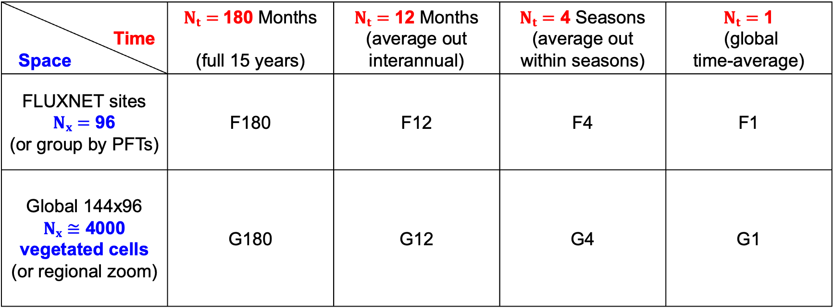
Several case studies
Time Space | $Nt=$180 Months (full 15 years) | $Nt=$ 12 Months (average out interannual) | $Nt=$ 4 Seasons (average out within seasons) | $Nt=$ 1 (global time-average)
FLUXNET sites $Nx=$ 96 (or group by PFTs) | F180 | F12 | F4 | F1
Global 144x96 $Nx≅$ 4000 vegetated cells (or regional zoom) | G180 | G12 | G4 | G1

Slide 12
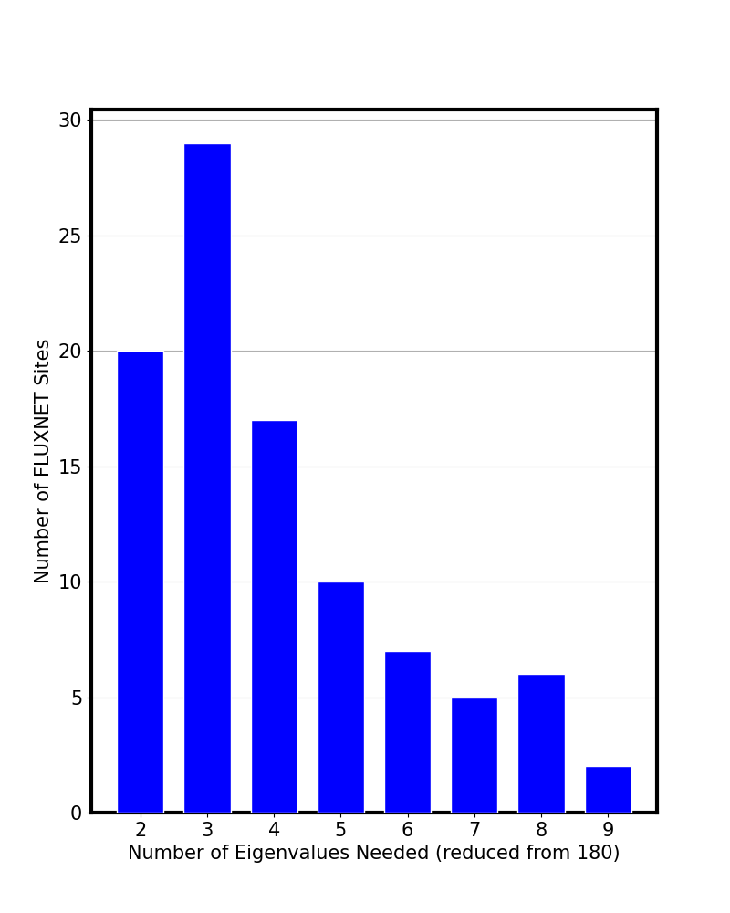
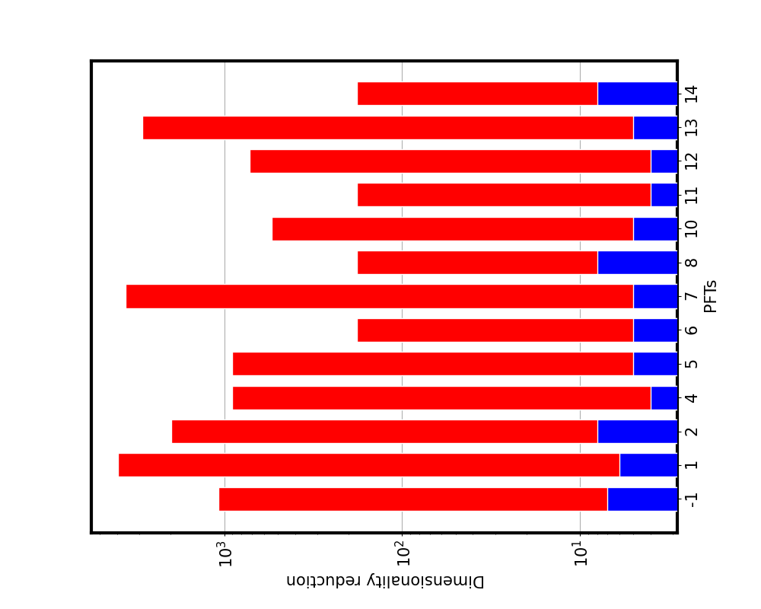
Dimensionality reduction via KL
Per-site dimensionality reduction
Per-PFT dimensionality reduction

Slide 13
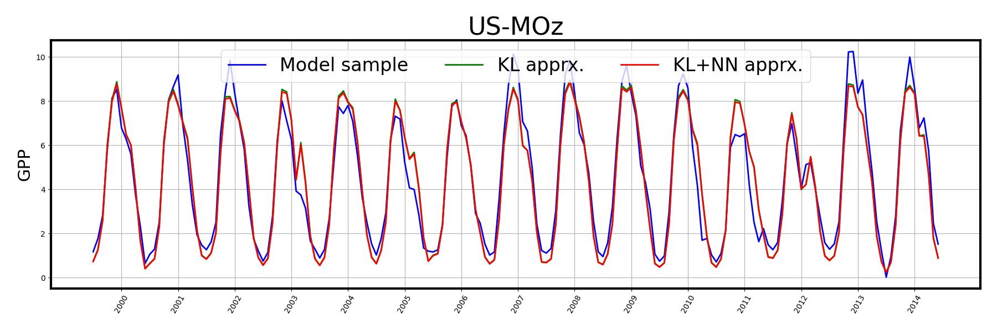
KL+NN a single training sample approximation

Slide 14
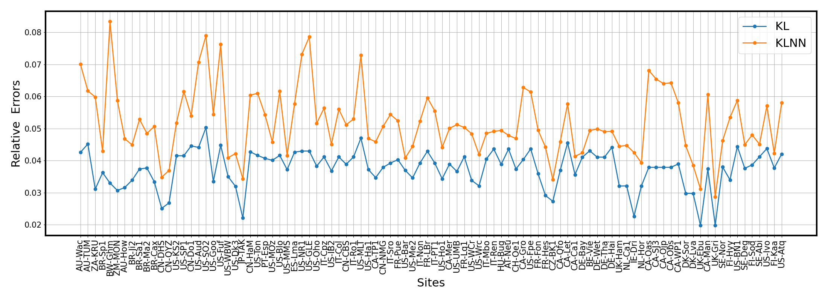
KL+NN surrogate performance
Instead of 96x180=17280 surrogates, we build
a single NN surrogate in the reduced, 8-dimensional latent space

Slide 15
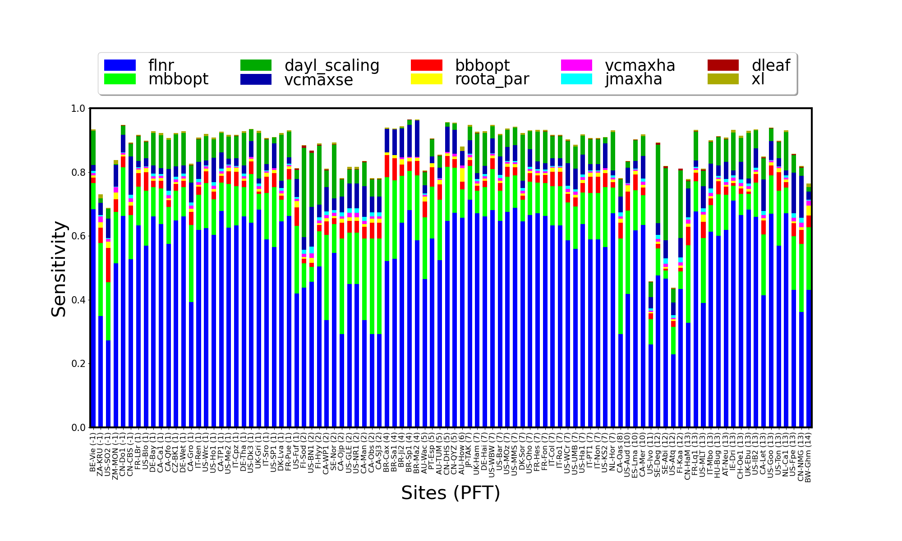
Sensitivity at 96 FLUXNET sites: RuBisCO leaf fraction is the most impactful parameter

Slide 16
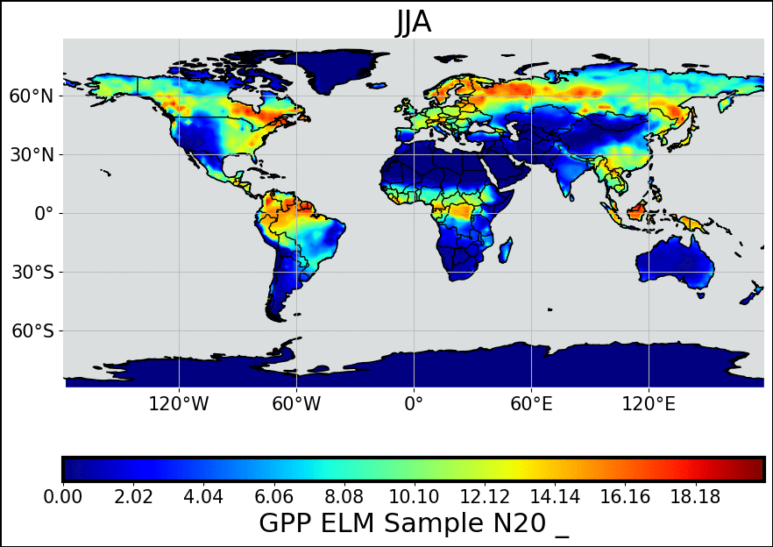
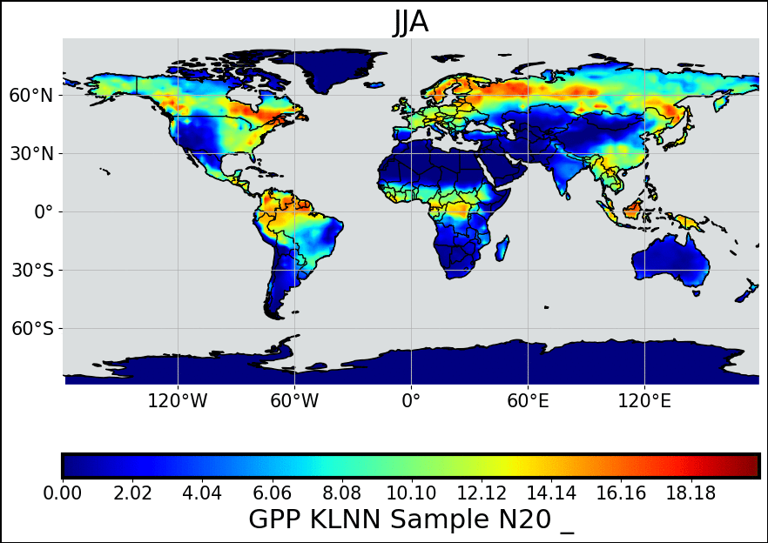
Dimensionality reduction from 4000 cells x 4 seasons = 16000 to 11-dimensional latent space
ELM Model Samples
KLNN Surrogate Samples

Slide 17
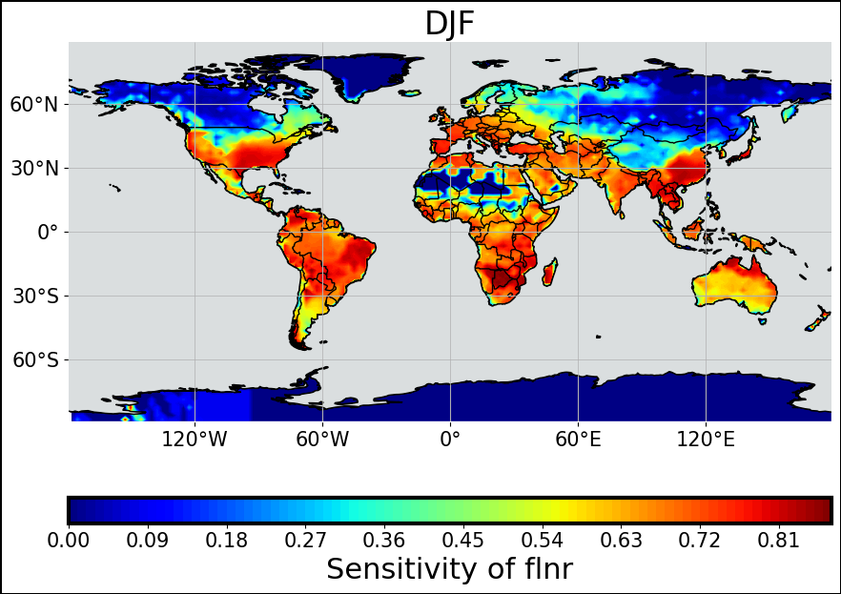
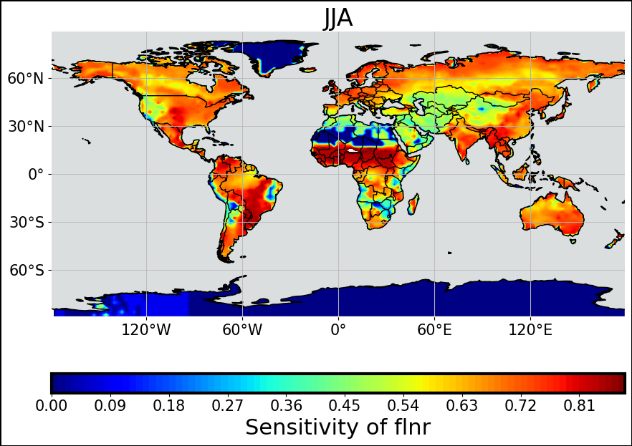
fLNR sensitivity across the globe
Notes:
Flnr is highly sensitive whenever photosynthesis is occurring, it is near zero only in very cold areas in the winter or desert areas. It is slightly less sensitive in dry areas, where stomatal conductance parameters increase in sensitivity (next slide)

Slide 18
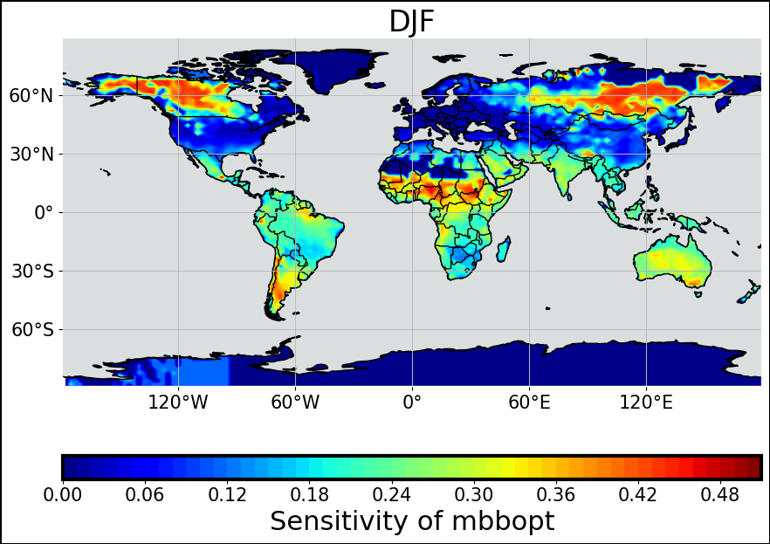
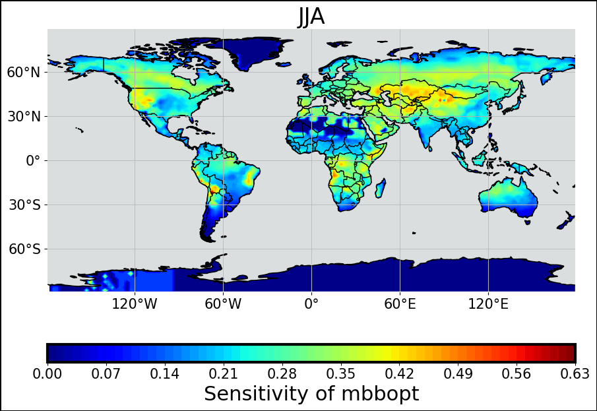
mbbopt sensitivity across the globe
Notes:
Mbbopt is the Ball-Berry stomatal conductance slope parameter. Show mbbopt as well in the summer, western US and in central asia, it should be high-ish. High areas in high latitudes are not as meaningful because GPP values are very small. Mbbopt is more sensitive in dray areas because it is a strong control on water use efficiency (transpiration per unit carbon uptake)

Slide 19
Inverse UQ a.k.a. calibration or parameter estimation

Slide 20
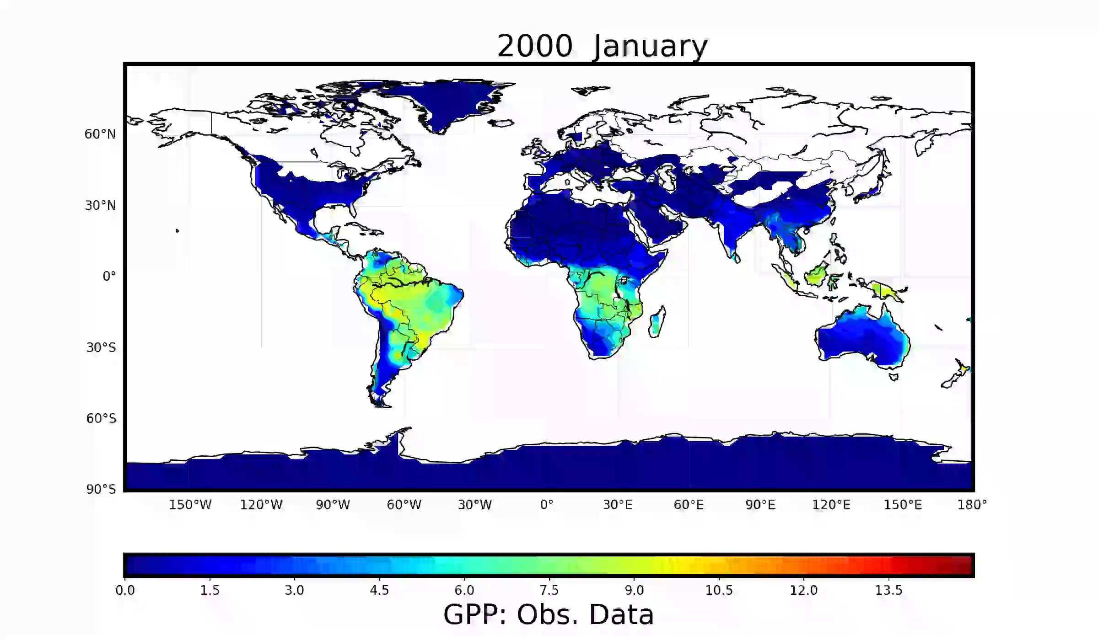
Reference Data
FLUXCOM: A gridded GPP benchmark
upscaled from FLUXNET network
using meteorology, remote sensing
https://www.fluxcom.org/

Slide 21
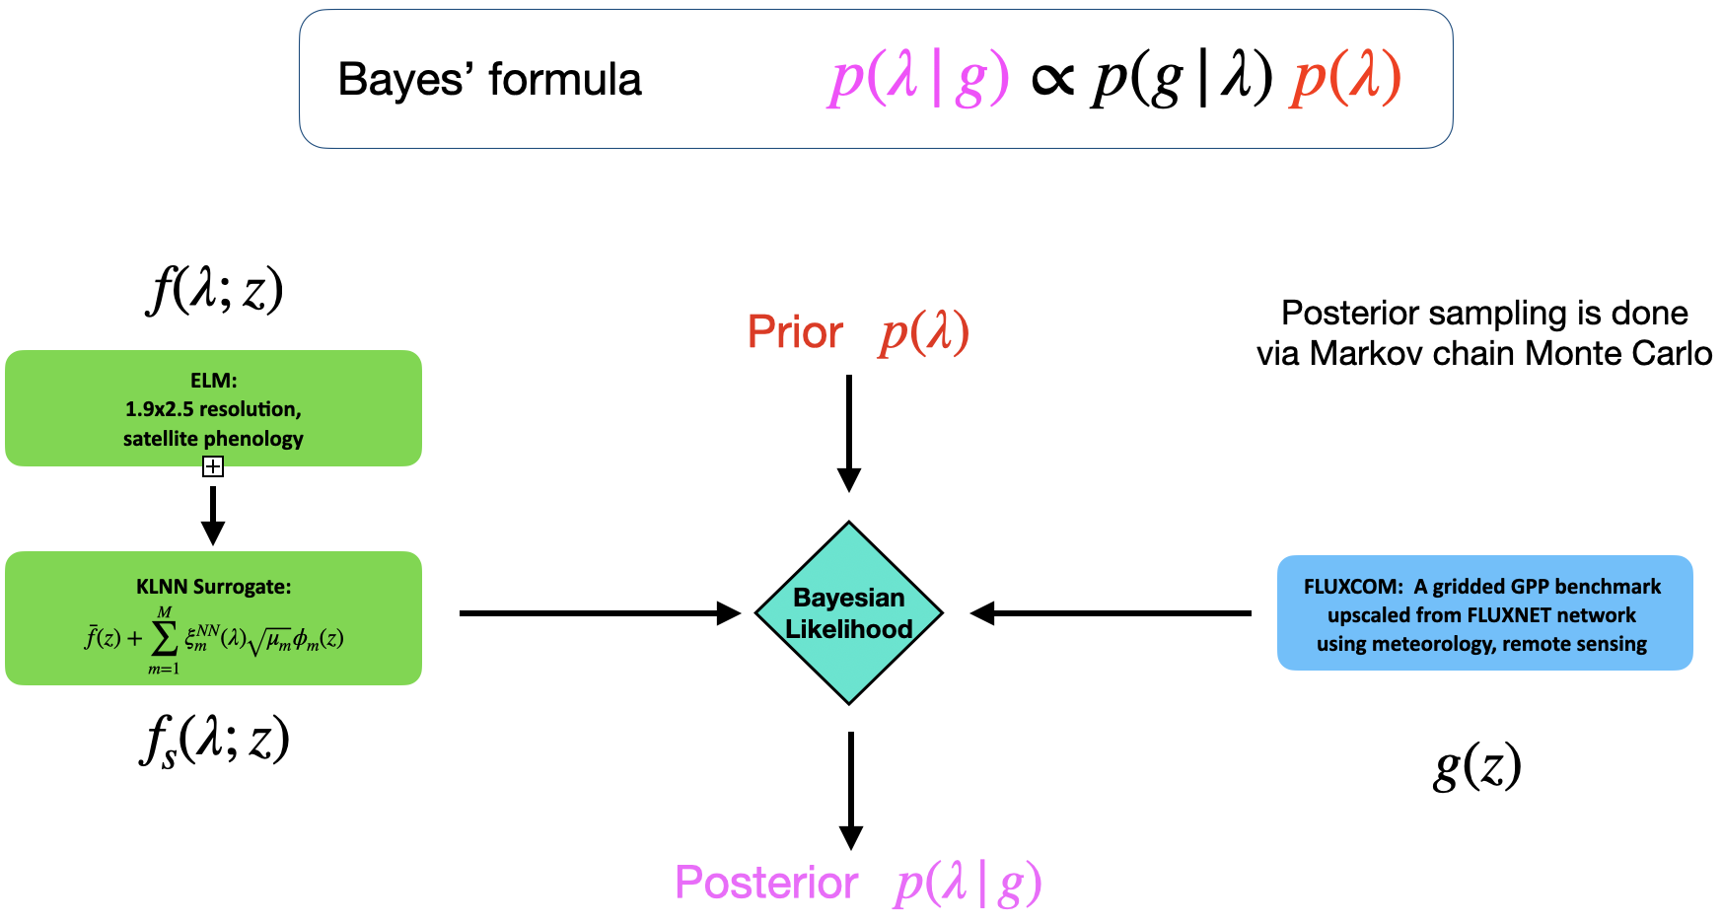

Slide 22
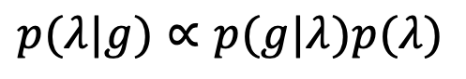
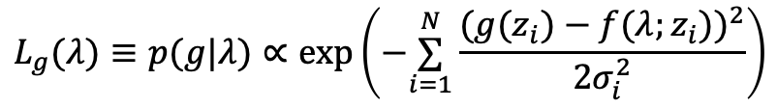
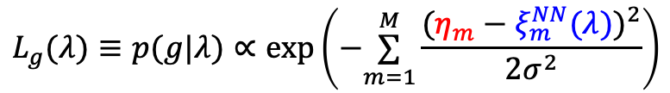
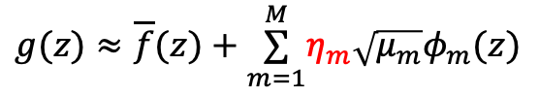
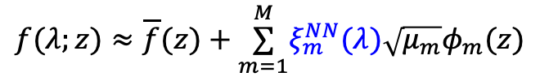
Bayesian Likelihood is constructed in the reduced space
Bayes’ formula
$$p(λ|g)∝p(g|λ)p(λ)$$
KLNN surrogate:
Project observed data to the KL eigenspace:
$$f(λ;z)≈\overline{f}(z)+\overset{M}{\underset{m=1}{∑}}ξ_{m}^{NN}(λ)\sqrt{μ_{m}}φ_{m}(z)$$
$$g(z)≈\overline{f}(z)+\overset{M}{\underset{m=1}{∑}}η_{m}\sqrt{μ_{m}}φ_{m}(z)$$
$$L_{g}(λ)≡p(g|λ)∝exp\left(−\overset{N}{\underset{i=1}{∑}}\frac{(g(z_{i})−f(λ;z_{i}))^{2}}{2σ_{i}^{2}}\right)$$
Pointwise likelihood (naïve) :
$$L_{g}(λ)≡p(g|λ)∝exp\left(−\overset{M}{\underset{m=1}{∑}}\frac{(η_{m}−ξ_{m}^{NN}(λ))^{2}}{2σ^{2}}\right)$$
Reduced likelihood :
Eigenfeatures $ξ_{m}$’s are uncorrelated, zero-mean, unit variance,
hence iid gaussian likelihood is a much better assumption in the reduced space.

Slide 23
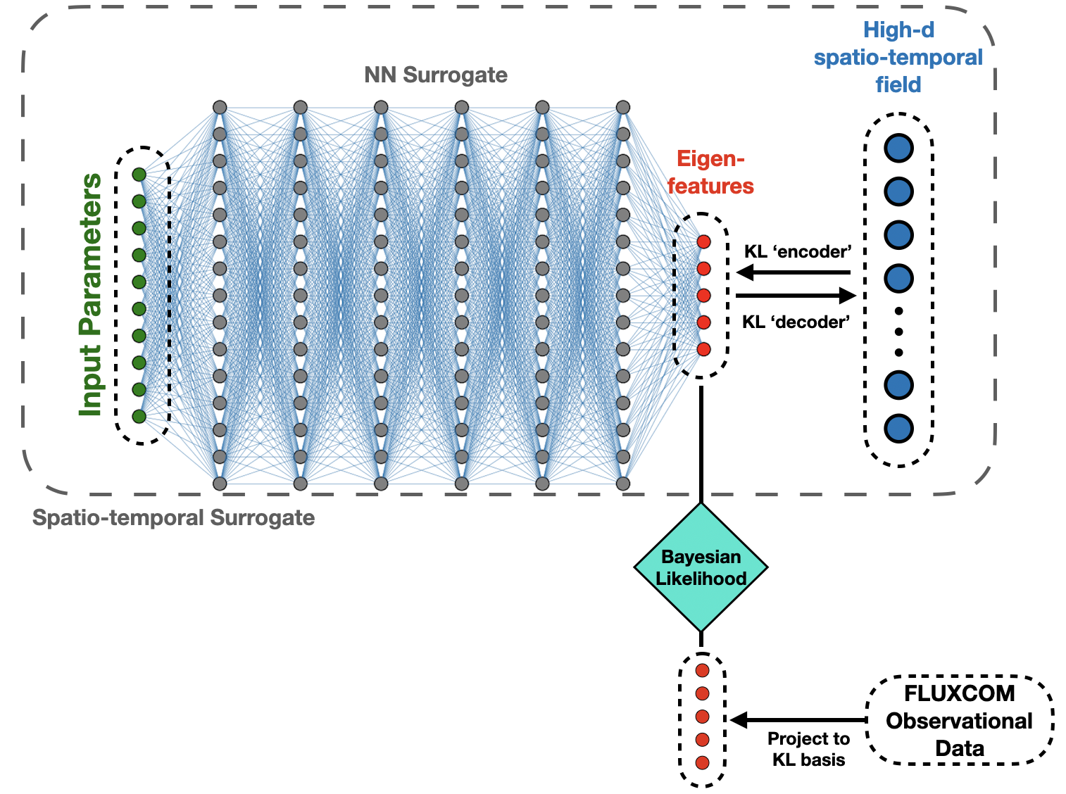
Surrogate-enabled calibration workflow incorporates both forward and inverse UQ tasks

Slide 24
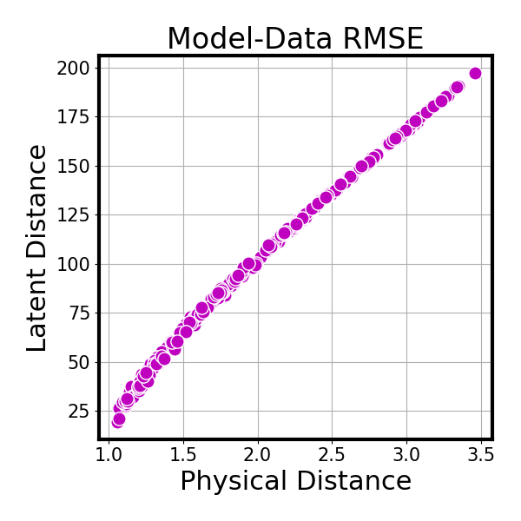
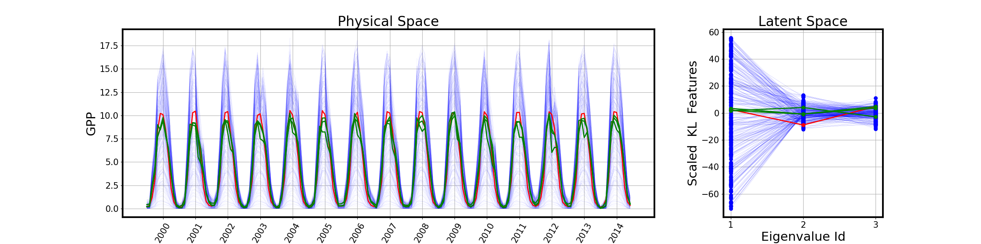
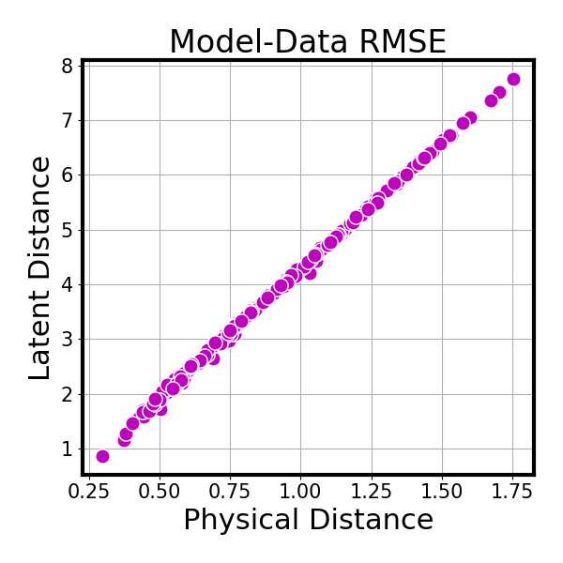
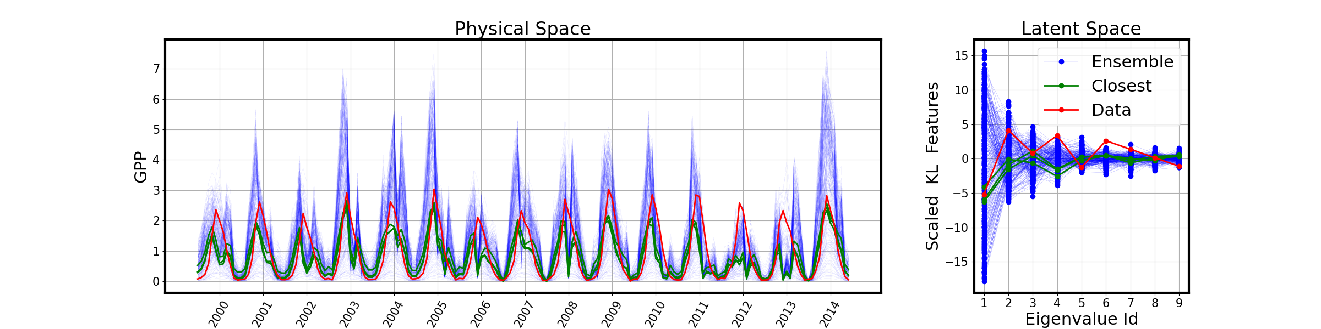
Latent space distance is well-correlated with the physical distance between model and data
US-Ha1
US-GLE

Slide 25
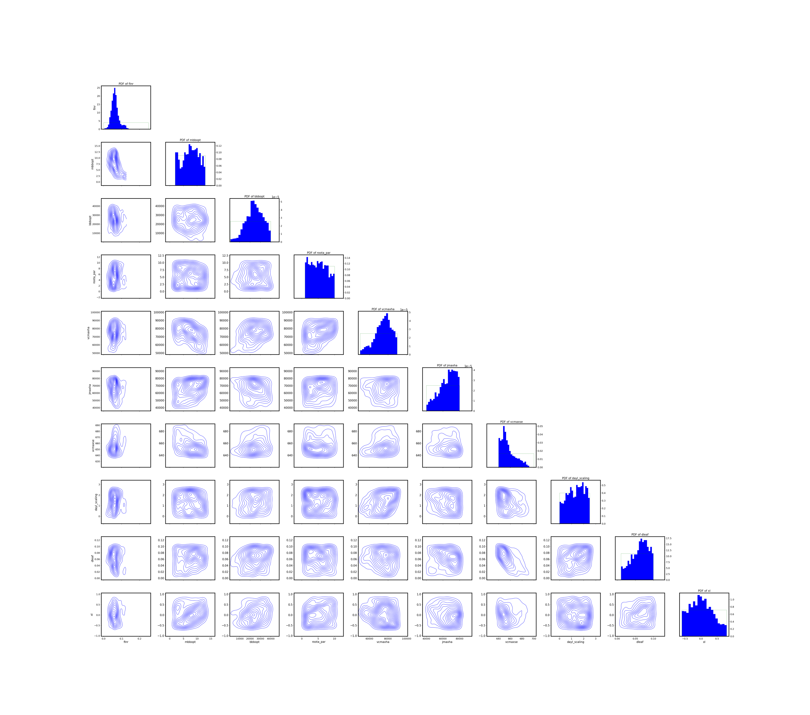
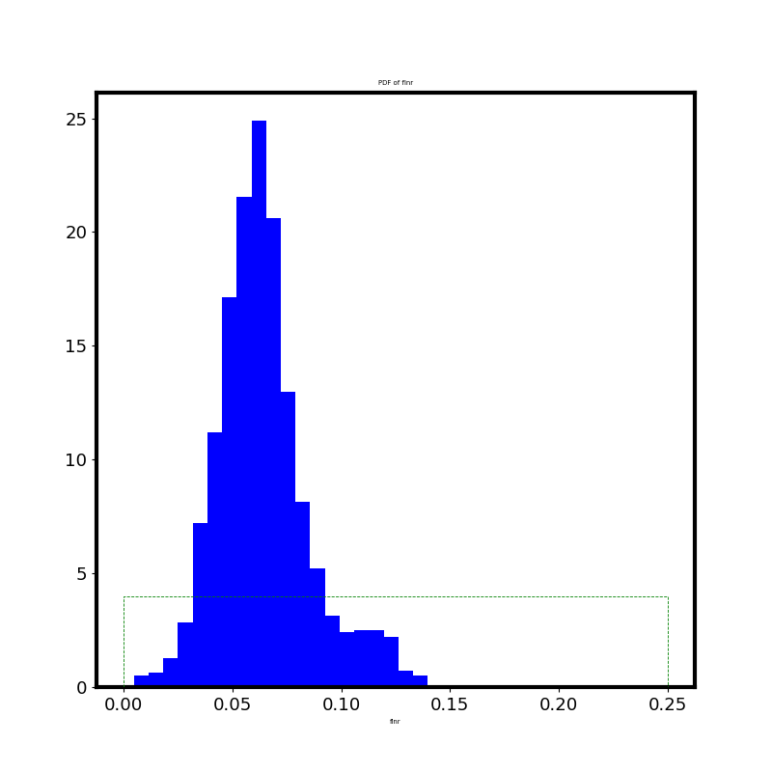
Bayesian MCMC calibration enabled by KLNN surrogate
RuBisCO leaf fraction (fLNR) is the most constrained parameter

Slide 26
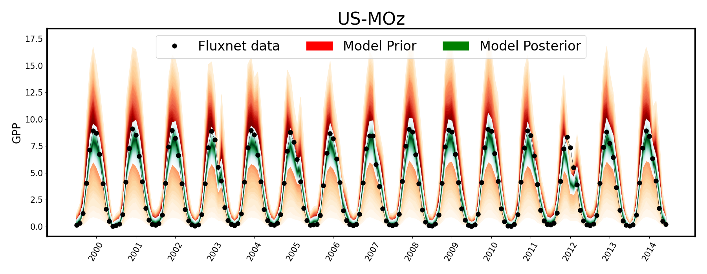
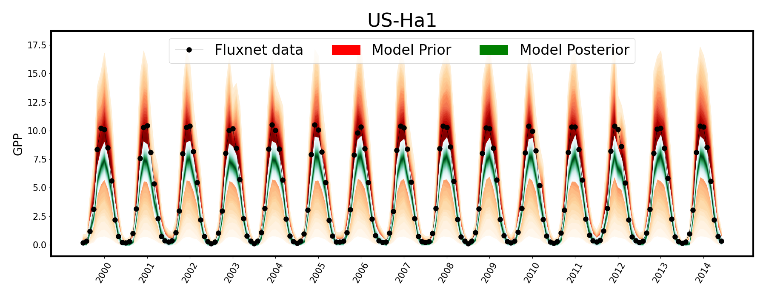
Time evolution
of GPP at select
FLUXNET sites

Slide 27
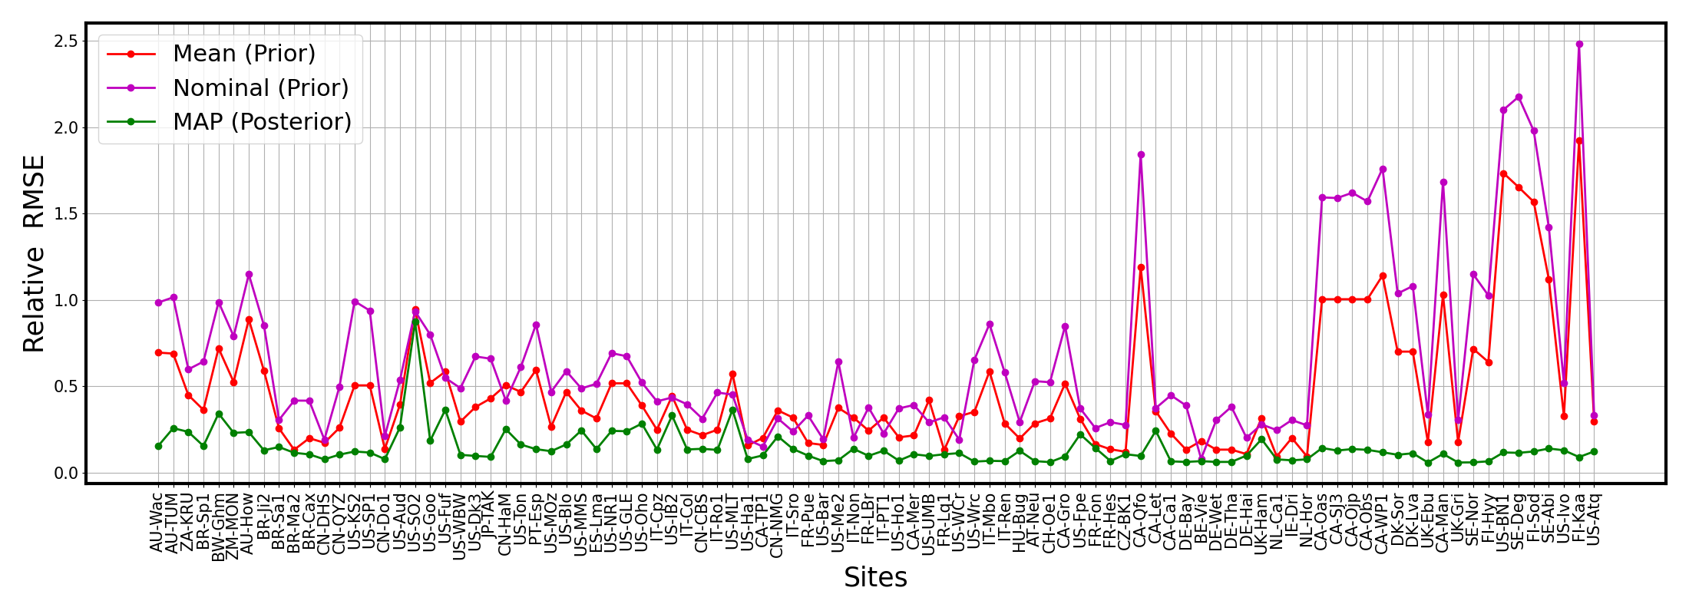
Calibration brings model prediction closer to reference data
Site-specific parameters

Slide 28
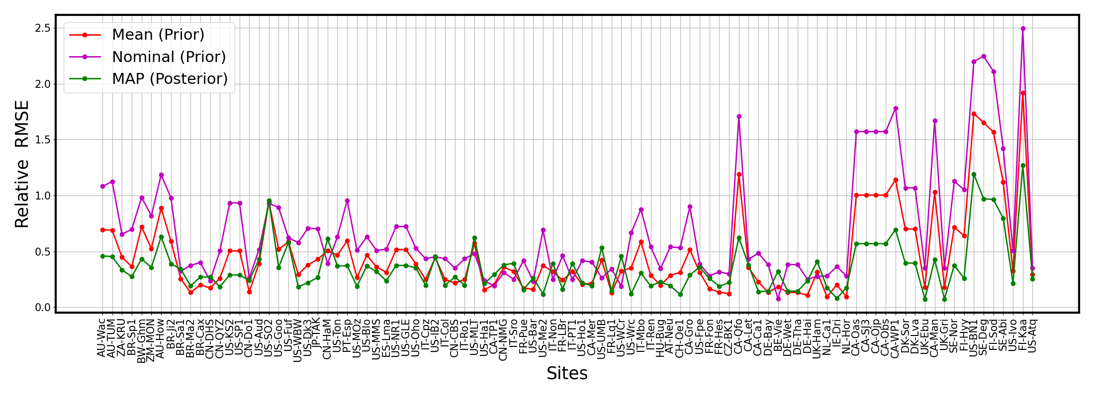
Calibration brings model prediction closer to reference data
Common parameters for all sites

Slide 29
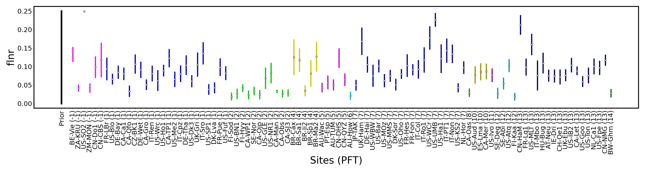
Local (site-specific) fLNR posterior PDFs
Grouped by PFTs

Slide 30






Nominal parameter (prior)
Max a posteriori (MAP)
Reference data
Winter
Summer

Slide 31


Two calibration regimes
One global surrogate
One surrogate per grid cell
Fixed global fLNR parameter
Local fLNR parameter

Slide 32

Localized calibration works slightly better

Slide 33

Correlate PFT fractions globally with best fLNR values
PFT Fractions for all PFTs

Slide 34






Correlate PFT fractions globally with best fLNR values

Slide 35
Summary
Karhunen-Loève (KL) decomposition reduces the spatio-temporal output dimensionality, taking advantage of correlations over space and time.
Neural network (NN) surrogate in the reduced eigenspace leads to a spatio-temporal KLNN surrogate that is a small fraction of ELM cost.
KLNN surrogate enables sampling based global sensitivity analysis and Bayesian calibration performed in the eigenspace.
Ongoing work:
Potential PFT-dependent reparameterization to improve model’s ability
to match reference data.
Calibration with embedded model discrepancy to avoid overfitting.

Slide 36
Additional Material

Slide 37




KL truncation relies on variance retention
$$f(λ;z)≈\overline{f}(z)+\overset{M}{\underset{m=1}{∑}}ξ_{m}(λ)\sqrt{μ_{m}}φ_{m}(z)$$
$$M = argminM′ \overset{}{\frac{\overset{M′}{\underset{m=1}{∑}}μ_{m}}{\overset{∞}{\underset{m=1}{∑}}μ_{m}}>0.99}$$
$$Var\left[f\left(z\right)\right]=\overset{M}{\underset{m=1}{∑}}μ_{m}{φ2}_{m}(z)$$
$$Var\left[f\right]=\overset{M}{\underset{m=1}{∑}}μ_{m}$$

Slide 38


Polynomial Chaos intro
Our traditional tool for uncertainty representation and propagation
Random variables represented as polynomial expansion of standard random variables,
such as gaussian or uniform
$$ξ=\overset{K}{\underset{k=1}{∑}}ck ψ_{k}(η)$$
Convenient for uncertainty propagation
$$f(ξ)=\overset{K}{\underset{k=0}{∑}}fk ψ_{k}(η)$$
Moment estimation
Global Sensitivity Analysis (a.k.a. Sobol indices or variance-based decomposition)

Slide 39




KL+PC = reduced dimensional spatio-temporal surrogate
The goal is to construct a surrogate with respect to uncertain parameters $λ$, such that $f(λ;z_{i})≈f_{s}(λ;z_{i})$ for all conditions $z_{i}$.
Instead of building surrogate for each individual $z_{i}$ for $i=1,…,N$,
we construct polynomial chaos (PC) surrogate for $ξ_{1},…,ξ_{M}$ where $M≪N.$
Eigen-
features
$$f(λ;z)≈\overline{f}(z)+\overset{M}{\underset{m=1}{∑}}ξ_{m}(λ)\sqrt{μ_{m}}φ_{m}(z)$$
Input Parameters
$$ξ_{1},…,ξ_{M}$$
$$λ_{1},…,λ_{d}$$
$$ξ_{m}^{PC}(λ)$$

Slide 40
PC vs NN comparison
Simple regression,
easy to train
GSA and variance decomposition,
More interpretable
Polynomial Chaos
More flexible,
highly customizable
Multiple outputs at once,
More accurate (in theory)
Neural Network

Slide 41


PC vs NN comparison
96 temporal surrogates
with each 180 outputs
Single spatio-temporal
surrogate
with 96x180 outputs

Slide 42








Bayesian Likelihood in the reduced space TBD
KLNN surrogate:
Project observed data to the KL eigenspace:
$$f(λ;z)≈\overline{f}(z)+\overset{M}{\underset{m=1}{∑}}ξ_{m}^{NN}(λ)\sqrt{μ_{m}}φ_{m}(z)$$
$$g(z)≈\overline{f}(z)+\overset{M}{\underset{m=1}{∑}}η_{m}\sqrt{μ_{m}}φ_{m}(z)$$
Pointwise likelihood (old) :
Data model (old) :
$$L_{g}(λ)≡p(g|λ)∝exp\left(−\overset{N}{\underset{i=1}{∑}}\frac{(g(z_{i})−f(λ;z_{i}))^{2}}{2σ_{i}^{2}}\right)$$
i.i.d. Normal
$$g(z_{i})=f(λ;z_{i})+σ_{i}ε_{i}$$
Data model (new) :
$$L_{g}(λ)≡p(g|λ)∝exp\left(−\overset{M}{\underset{m=1}{∑}}\frac{(η_{m}−ξ_{m}^{NN}(λ))^{2}}{2σ^{2}}\right)$$
$$η_{m}=ξ_{m}^{NN}(λ)+σ{\overset{˜}{ε}}_{m}$$
MVN (physics-based)
$$g(z_{i})=f(λ;z_{i})+\overset{M}{\underset{m=1}{∑}}{\overset{˜}{ε}}_{m}\sqrt{μ_{m}}φ_{m}(z_{i})$$

